Slide 1
Register to Kaggle.com
Go to kaggle.com
Sign in using a Google Account
Go to Account / Account Tab / API / Create New API Token

Slide 2

DLMRA Open Lab #1
Image Features, Visual Similarity Search,
Visual Clustering, Classification
24 Maggio 2021

Slide 3
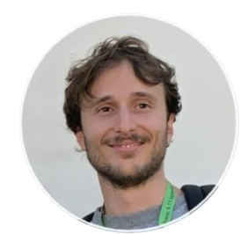
Fabio Carrara
fabio.carrara@isti.cnr.it
https://github.com/fabiocarrara
PhD in Computer Engineering @ UniPi
Deep Learning for Image Representation and Retrieval
PostDoc @ Istituto di Scienza e Tecnologie dell'Informazione (ISTI) - CNR
AIMH (Artificial Intelligence for Media and Humanities) Lab

Slide 4
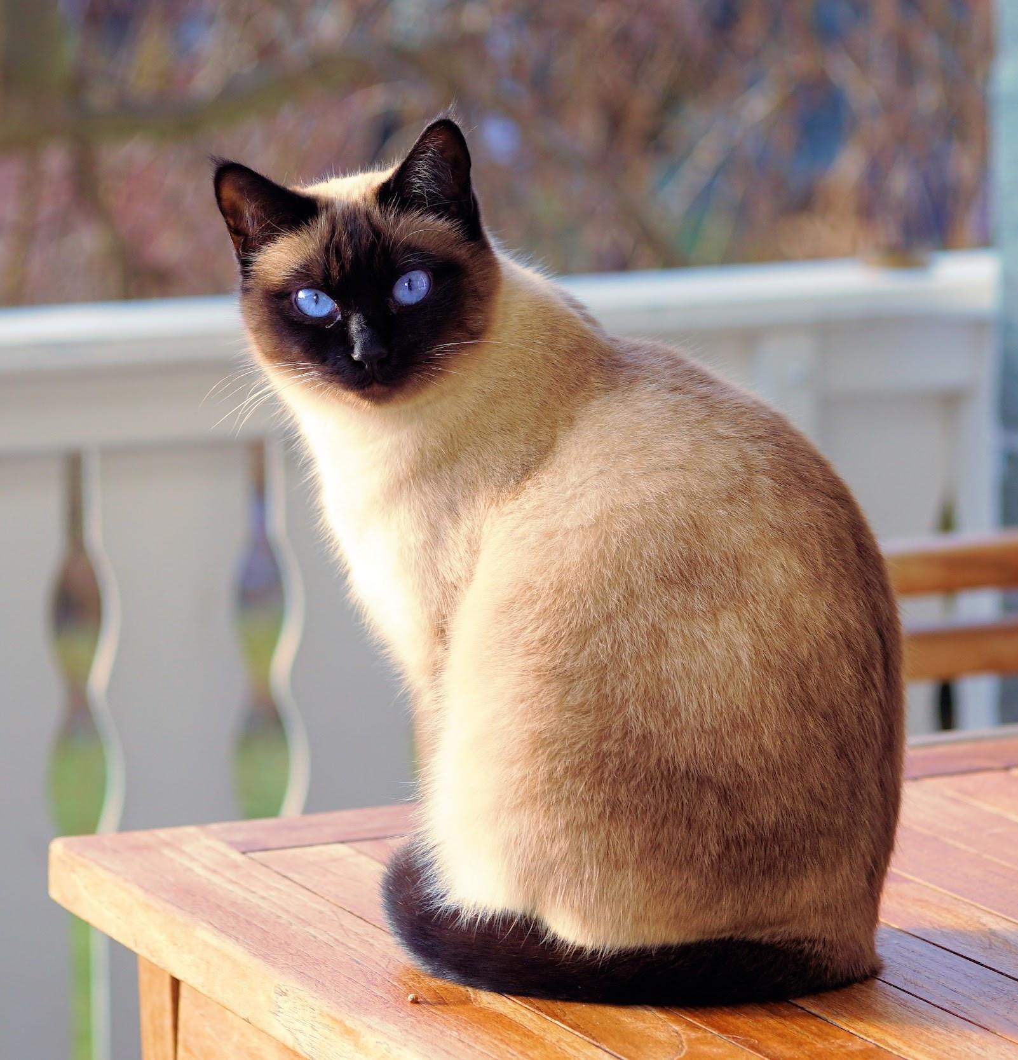
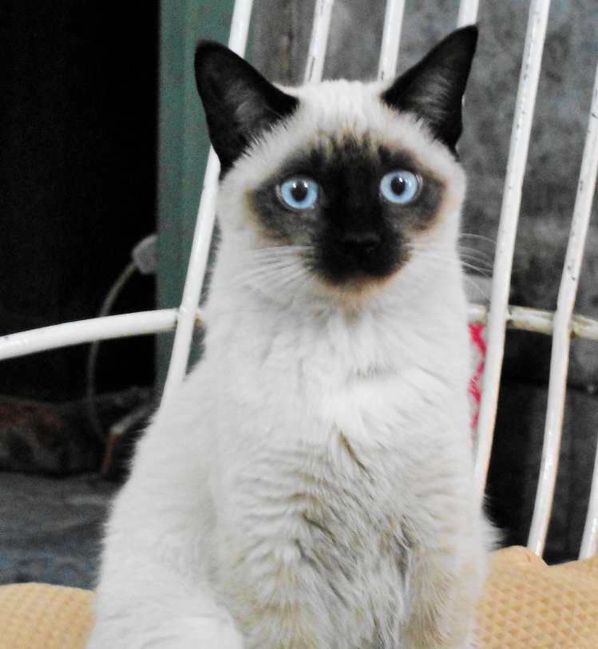
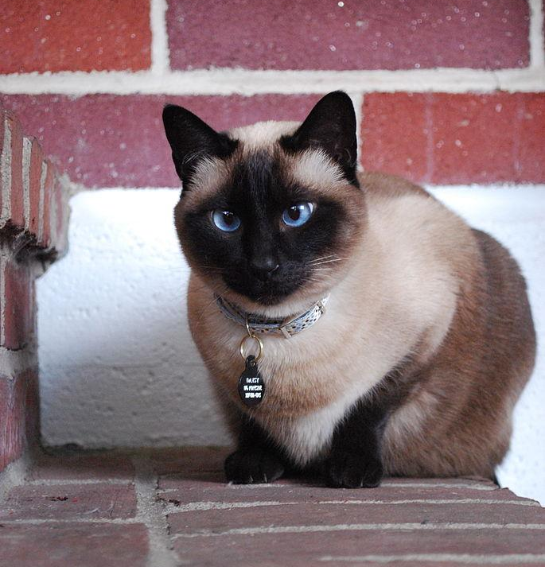
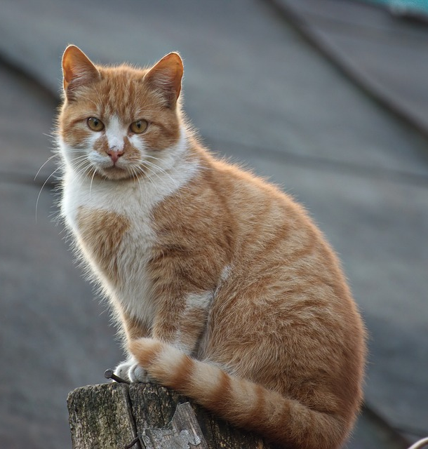
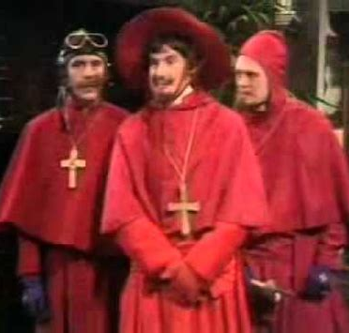
What we will do today (I)
Extract Image Features with Pre-trained CNNs
Perform Visual Similarity Search (kNN query)
CNN
0.2, 5.6, -0.3 …
Query
Results
...
0.98
0.95
0.83
0.05

Slide 5
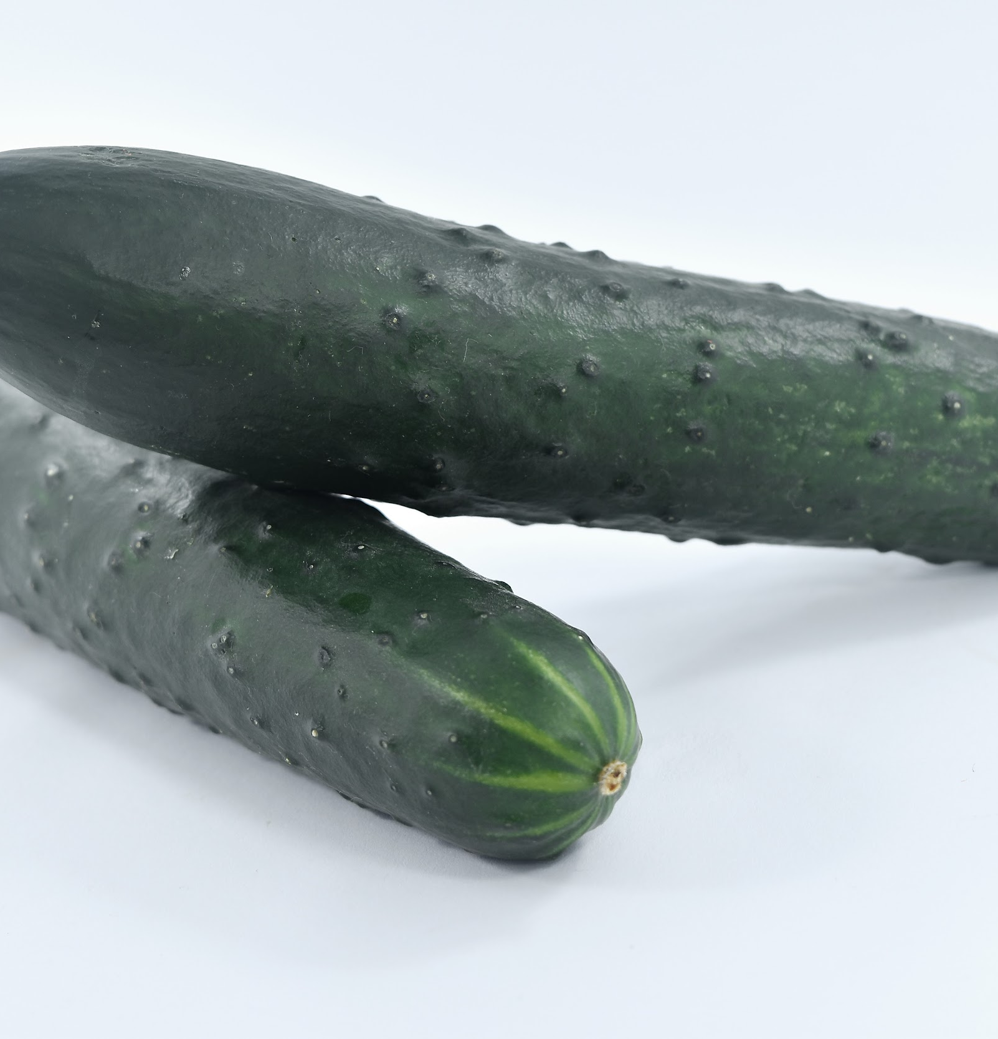
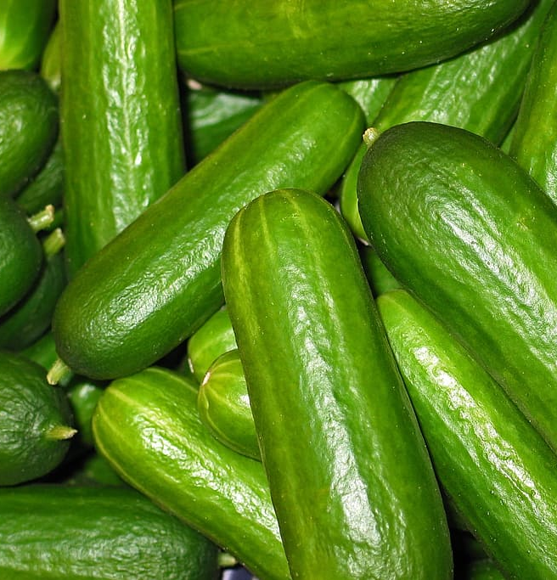
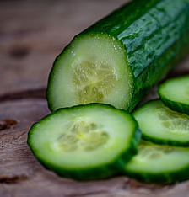
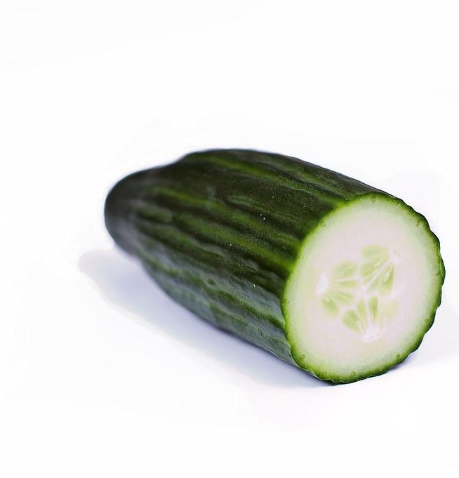
What we will do today (II)
Perform Image Clustering by Visual Similarity (K-means)
Image Classification with Transfer Learning (SVM on Features)
...
Cluster #1
Cluster #K
...
Siamese Cat
Shallow Classif. (SVM)
Non-Siamese Cat

Slide 6
Libraries & Technologies
numpy (multi-dimensional arrays)
matplotlib (plotting)
TensorFlow / Keras (deep neural networks)
Services we will use (you will need a Google Account):
Google Colab (for a pre-installed environment and speed via GPUs)
Kaggle (as a source of datasets easily importable into Colab)
TensorFlow Hub (collection of ready-to-use pretrained model for TF)

Slide 7
To Colab

